Slide 1
Mandatum AM Senior Loan Strategy PRE-CONTRACTUAL DISCLOSURE OF A PRODUCT THAT PROMOTES E/S CHARACTERISTICS PURSUANT TO ARTICLE 8 OF THE SFDR

Slide 2
Environmental or social characteristics promoted by this product
Mandatum AM Senior Loan Strategy investment basket promotes, among other characteristics, environmental or social characteristics, or a combination of those characteristics and the companies in which the investments are made follow good governance practices pursuant to article 8 of the Regulation 2019/2088 of the European Parliament and of the Council on sustainability‐related disclosures in the financial services sector (SFDR).
The Mandatum AM Senior Loan Strategy investment basket primarily invests in unlisted loan arrangements of European and North American companies. The loans are mainly issued by European and North American companies under private loan arrangements.
Mandatum Life Insurance Company Ltd and its portfolio manager Mandatum Asset Management Ltd (combined “Mandatum”) invest their customers’ funds responsibly, and responsibility forms a key part of Mandatum’s risk management process. Mandatum believes that, in the long run, the securities of companies and issuers who operate responsibly will yield better results as investment objects, thanks to their more favourable growth prospects and more predictable cost development.
For these reasons, Mandatum incorporated responsibility into its investment operations, and its investment decisions take into account not only financial aspects, but also factors related to the environment, society, employees, respect for human rights, and anti-corruption and anti-bribery (hereinafter sustainability factors), as well as the related risks.
When analysing the risks of an investment object, Mandatum considers environmental, social and governance factors as part of the whole. In decision-making, Mandatum employs both negative and positive screening, taking the special characteristics of different asset classes into account.
Mandatum’s approach is to impact companies’ operating methods in terms of responsibility also as an active owner by meeting with the management of the companies and through engagement together with other investors. When selecting direct investments, Mandatum takes sustainability matters into account as part of the investment object analysis. Investments are continuously monitored from a sustainability perspective. Portfolio managers and analysts monitor the news flow on their investment objects daily, in addition to which an external service provider specialising in sustainability matters reviews the investments quarterly.
The Adverse Sustainability Impacts Statement is published on the Website.
The investments are monitored on the basis of the UN Global Compact principles. The principles are based on international standards concerning human rights, labour rights, the environment and corruption. Additionally, Mandatum has set limits on investments in companies whose business involves controversial weapons, war materials, coal, tobacco, adult entertainment, alcohol or gambling.
The carbon footprint of investments is measured and disclosed annually.
The ESG characteristics promoted by this investment basket are measured and monitored through Norm Based Screening and Carbon Footprint. Investments are monitored on a quarterly basis. Norm Based Screening and Carbon Footprint are presented as latest available information.

Slide 3
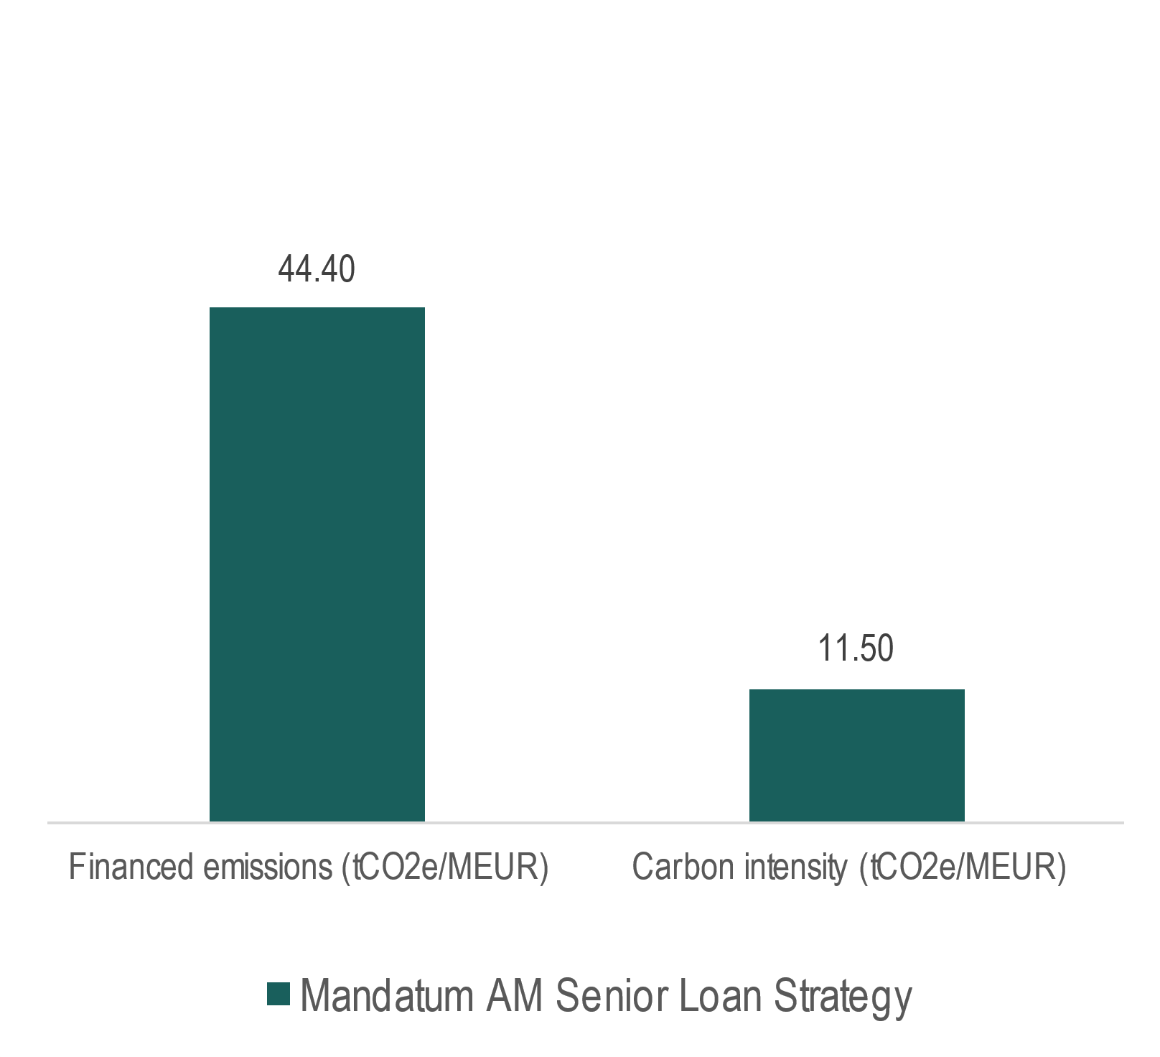
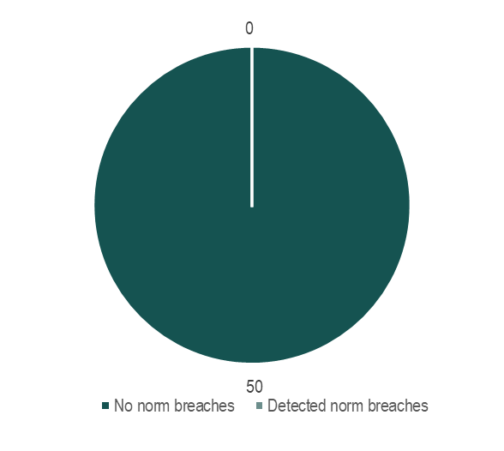
Carbon Footprint
Norm Based Screening
No sustainable investment objective
This product does not have as its objective sustainable investment.
Investment strategy
The investment basket primarily invests in unlisted loan arrangements of European and North American companies. The loans are mainly issued by European and North American companies under private loan arrangements.
Good governance assessment
The investments are monitored on the basis of the UN Global Compact principles. The principles are based on international standards concerning human rights, labour rights, the environment and corruption. If abuses or breaches related to these standards are observed in the investee company, the incident is investigated, and measures are taken on a case-by-case basis. Depending on the severity, nature and extent of the breach, the portfolio management measures may consist of direct dialogue with the company’s executive management, an engagement action or, as a last resort, selling the investment if the engagee company does not respond to the engagement efforts and does not take measures to prevent the abuse or breach within a reasonable time frame.

Slide 4
Binding elements of investment strategy
Different industries/product groups have been divided into tolerance categories based on how much of the company’s net sales is generated, either directly or indirectly, by the business in question:
a) Zero tolerance: the investment object must have no direct or indirect net sales from the business in question.
b) Low tolerance: the investment object must have no direct net sales from the business in question. The limit for indirect net sales is 50%.
c) Partial tolerance: the business in question must not be the investee’s main business (more than 50% of net sales).
In addition to standard- and business-based monitoring, the carbon footprint of investments is determined annually and monitored separately for each investment basket.
The responsible portfolio manager for each fund or responsibility area is responsible for effectively managing the climate risk of the investment object he/she manages, in line with the commitments made by Mandatum.
When selecting direct investments, Mandatum takes sustainability matters into account as part of the investment object analysis.
Investments are continuously monitored from a sustainability perspective. Portfolio managers and analysts monitor the news flow on their investment objects daily, in addition to which an external service provider specialising in sustainability matters reviews the investments quarterly.
The investments are monitored on the basis of the UN Global Compact principles. The principles are based on international standards concerning human rights, labour rights, the environment and corruption. Additionally, Mandatum has set limits on investments in companies whose business involves controversial weapons, war materials, coal, tobacco, adult entertainment, alcohol or gambling.

Slide 5
Sustainability indicators
The sustainability analysis of an investment is based on information collected from public sources. Sustainability is analysed in both quantitative and qualitative terms. Direct dialogue is a key component of the sustainability analysis of an investment object. To back their analysis, portfolio managers and analysts also use the sustainability analysis of an external service provider.
The investments are also monitored on the basis of the UN Global Compact principles. The principles are based on international standards concerning human rights, labour rights, the environment and corruption. If abuses or breaches related to these standards are observed in the investee company, the incident is investigated, and measures are taken on a case-by-case basis. Depending on the severity, nature and extent of the breach, the portfolio management measures may consist of direct dialogue with the company’s executive management, an engagement action or, as a last resort, selling the investment if the engagee company does not respond to the engagement efforts and does not take measures to prevent the abuse or breach within a reasonable time frame.
The carbon footprint of investments is determined annually and monitored separately for each investment basket.
Use of derivatives
The investment basket may enter into financial derivatives contracts for the purpose of hedging, efficient portfolio management and/or implementing its investment strategy.
Does this financial product take into account principal adverse impacts on sustainability factors?
Yes.
Website reference
More product-specific information can be found on the Website.
Reference benchmark
The investment basket is actively managed but does not have a benchmark index.
Mandatum Life Insurance Company Limited. Postal address: PO Box 627, 00101 Helsinki. Registered office and address Bulevardi 56, 00120 Helsinki, Finland. Business ID 0641130-2.www.mandatumlife.fi
Mandatum Asset Management Ltd. Postal address P.O. Box 1221, FI-00101 Helsinki, Finland. Registered office and address Bulevardi 56, FI-00120 Helsinki, FINLAND. Business ID 2608438-8 www.mandatumlife.fi

